Slide 1

Department of Computer Science and Engineering
Heart Disease Prediction through Hybrid LSTM and HREF Models
PRESENTED BY
Srilakshmi Mutyam 22471A0541
Durga Vyshnavi Grandhisila 22471A0524
Rabia Basri Shaik Kagaji 22471A0550
Under the Guidance of,
Dr. Sireesha Moturi, M.Tech.,Ph.D.,
ASSOC.PROFESSOR
Department of Computer Science and Engineering,
Narasaraopet Engineering College (Autonomous),
Narasaraopet- 522 601.

Slide 2
INDEX
Abstract
Introduction
Literature Survey
Research Gaps
Block diagram / Flow diagram
Methodology
Results & Analysis
Conclusion & Future Scope
References

Slide 3
ABSTRACT
Heart disease is a leading cause of global mortality and requires accurate early prediction. Traditional diagnosis methods may fail to capture hidden clinical patterns in patient data. Heart disease affects men, women, and all age groups differently — men are more prone at a younger age due to stress, smoking, and genetic factors; women face higher risk after menopause because of hormonal changes; and the risk increases with age for everyone as arteries stiffen and metabolism slows. This project proposes a Hybrid BiLSTM + HREF model for improving prediction accuracy. The Cleveland heart disease dataset (303 samples, 14 features) is used for model training. Preprocessing includes outlier removal, normalization, imputation, and SMOTEENN balancing. BiLSTM captures nonlinear feature dependencies, while HREF refines predictions using ensemble learning. The proposed model achieves 94.7% accuracy and 0.9474 ROC-AUC, outperforming baseline models. Results show that the hybrid framework is reliable for early heart disease detection and clinical decision support.

Slide 4
INTRODUCTION
Cardiovascular diseases (CVDs) are the leading global cause of death (~17.9 million annually).
Early and accurate diagnosis reduces mortality and improves patient outcomes.
Traditional diagnostic methods are subjective and limited.
Deep Learning (DL) and Machine Learning (ML) techniques can identify complex, hidden patterns in medical data.
The proposed research introduces a Hybrid BiLSTM + HREF model for precise heart disease prediction using the Cleveland dataset.

Slide 5
LITERATURE SURVEY
Alghamdi et al. (2024) proposed a hybrid Autoencoder- DenseNet model for heart disease prediction and achieved improved feature learning.
Gabriel & Anbarasi (2024) optimized LightGBM with feature selection. Showing higher accuracy in clinical datasets.
Boquete et al. (2024) used machine learning with feature engineering to enhance early heart disease detection.
Narasimhan & Victor (2025) implemented Genetic Algorithm-optimized Random Forest for better classifier performance.
Teja & Rayalu (2025) proved that ensemble models outperform individual classifiers in heart disease classification tasks.

Slide 6
RESEARCH GAPS
Existing ML and DL models struggle to handle class imbalance, leading to biased predictions.
Most previous works do not integrate BiLSTM with ensemble refinement, limiting performance .
Lack of robust preprocessing pipelines involving outlier removal, normalization, and SMOTEENN.
Many models fail to capture deep nonlinear feature dependencies in clinical datasets.
Limited use of stacked meta-learning frameworks for improving model generalization.
Insufficient research on combining deep learning + hybrid ensemble techniques for medical diagnosis.
Need for a more accurate, stable, and clinically reliable prediction model.

Slide 7

PROBLEM STATEMENT
To develop a highly accurate and reliable hybrid BiLSTM–HREF model that overcomes data imbalance, captures complex clinical patterns, and improves early prediction of heart disease compared to existing machine learning approaches.
Early prediction of heart disease helps prevent severe complications and reduces mortality.
Accurate models support doctors in identifying high-risk patients at the right time.
Helps improve clinical decision-making through data-driven insights.
Contributes to developing reliable AI-based tools for real-world healthcare use.

Slide 8

OBJECTIVES
To develop a Hybrid BiLSTM + HREF models for accurate heart disease prediction.
To apply strong data preprocessing (outlier removal, normalization, imputation, SMOTEENN) for clean and balanced data.
To enable BiLSTM to learn deep nonlinear relationships within clinical features.
To improve overall performance and generalization using the Hybrid Refined Ensemble Framework (HREF) and evaluate results using standard metrics.

Slide 9
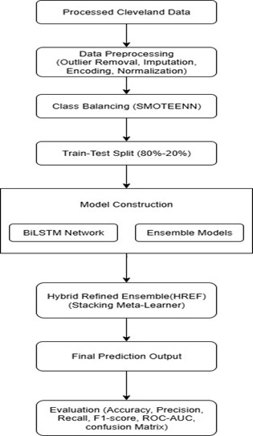
BLOCK DIAGRAM / FLOW DIAGRAM

Slide 10
METHODOLOGY
Dataset Description:
The project uses the Cleveland Heart Disease Dataset, one of the most widely used benchmark datasets for cardiovascular disease prediction.
It contains 303 patient records with 14 clinical features related to heart health.
age | Sex (Gender) | Cp (Chest Pain) | Trestbps (Resting Blood Pressure) | Chol (Serum Cholesterol) | Fbs (Fasting Blood Sugar) | Restecg (Resting ECG Results)
63 | 1 | 1 | 145 | 233 | 1 | 2
67 | 1 | 4 | 160 | 286 | 0 | 2
67 | 1 | 4 | 120 | 229 | 0 | 2
37 | 1 | 3 | 130 | 250 | 0 | 0
41 | 0 | 2 | 130 | 204 | 0 | 2

Slide 11
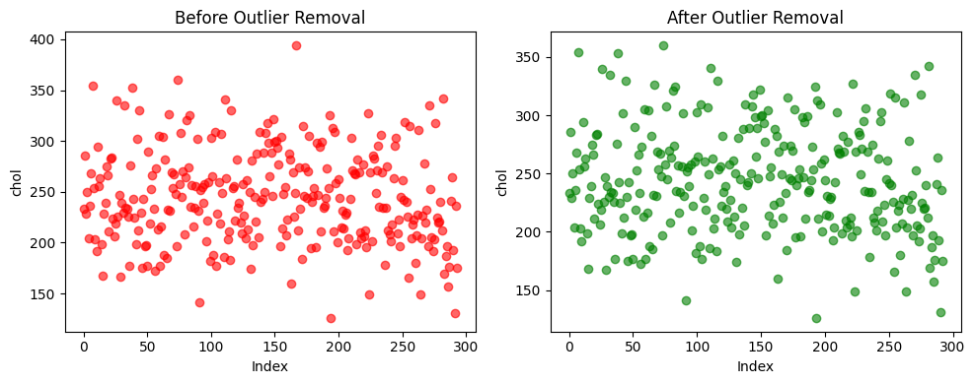
PREPROCESSING STEPS:
Outlier Removal :
Removal extreme values using z-score method to reduce noise.
After applying Z-Score, extreme and abnormal values in features like chol, trestbps, and oldpeak were removed.
The dataset became cleaner, smoother, and more consistent, reducing noise.
Feature distributions
became more uniform and
closer to normal ranges.
Overall data quality
improved, leading to better
accuracy and generalization.

Slide 12
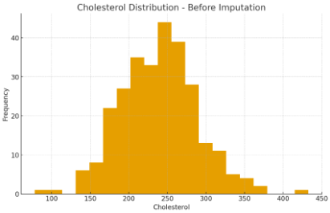
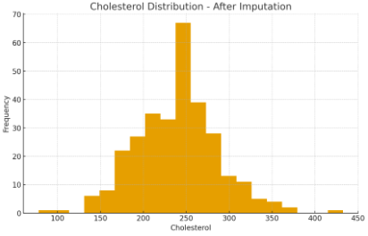
Missing Value Imputation
Filling missing clinical attributes for consistent model training.
All missing values in the dataset were successfully filled using the column mean
The dataset now contains 0 missing values, making it complete for model training.
The distribution of the
Feature e.g., cholesterol
became smooth and
continuous after
imputation.
The imputed values reduced gaps in data and improved overall data quality.

Slide 13

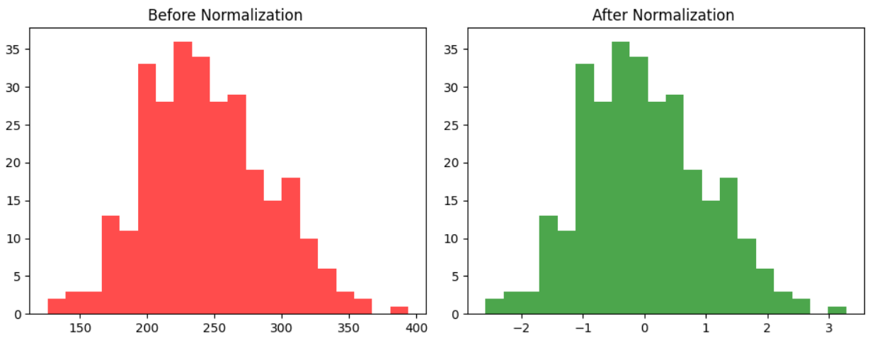
Normalization
All feature values were scaled to a common range, removing differences in magnitude.
Features with large values
(like cholesterol, blood
pressure) no longer
dominate the model.
The distribution of each
feature is centered around
0 mean and unit variance.
Model training becomes more stable and faster after normalization.
Overall, normalization improved model performance and ensured balanced feature contribution.

Slide 14
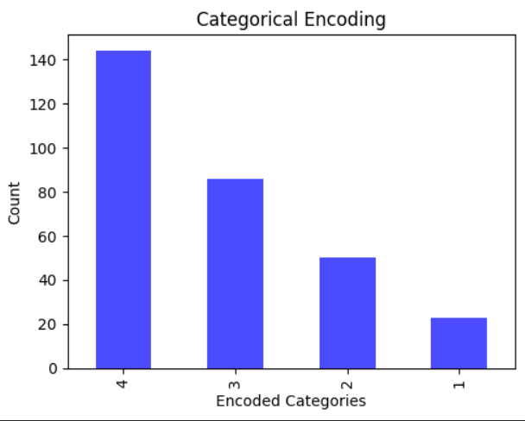
Encoding
All categorical features were successfully converted into numerical values.
The dataset became fully
numeric and compatible with
ML/DL models.
Encoded columns now contain
0s, 1s, or label numbers instead
of text categories.
The overall dataset structure
is cleaner and ready for normalization and training.

Slide 15
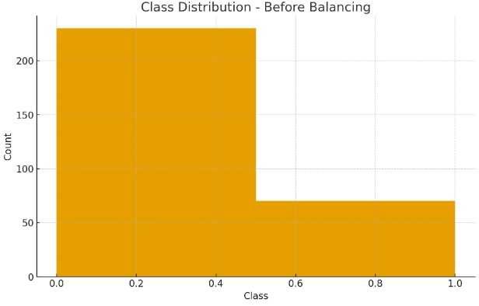
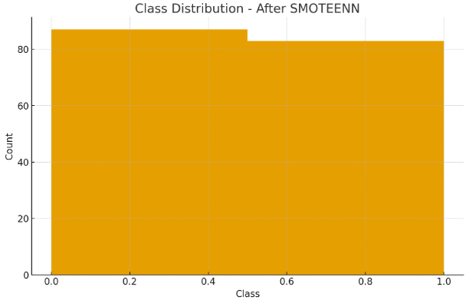
Class Balancing
Used SMOTEENN for oversampling minority class and cleaning noisy samples.
The dataset
became balanced,
with equal or
nearly equal
samples in both
classes.
Synthetic minority samples were created, increasing the number of “disease” cases.
Noisy and misclassified samples were removed, improving data quality.
The final dataset is cleaner, more stable, and better suited for accurate model training.

Slide 16
Algorithms
BiLSTM (Bidirectional Long Short-Term Memory)
A deep learning model that processes data in both forward and backward directions.
Captures sequential patterns and dependencies between features.
Highly effective for learning nonlinear relationships in tabular clinical data.
How it is useful :
Learns complex medical feature interactions (age, chol, thalach, oldpeak, etc.).
Extracts deeper patterns that simple ML models cannot detect.
Improves feature representation before ensemble refinement.
Boosts accuracy and reduces false predictions.

Slide 17
Random Forest (RF)
A supervised ML algorithm that finds the best separating boundary (hyperplane) between classes.
An ensemble of many decision trees.
Uses bagging (bootstrap aggregating) to reduce variance.
Produces stable and reliable outputs.
How it is useful :
Handles nonlinear clinical data very well.
Reduces overfitting with multiple trees.
Provides strong baseline predictions for the HREF framework.

Slide 18

AdaBoost (Adaptive Boosting)
A boosting ensemble technique that combines many weak learners into one strong model.
A boosting algorithm that focuses on misclassified samples.
Each new learner focuses more on the misclassified samples from previous learners.
How it is useful :
Helps improve classification of difficult heart disease samples.
Increases recall by correctly identifying more “disease” cases.
Enhances overall performance when combined with RF and BiLSTM.

Slide 19
Support Vector Machine (SVM)
Finds the best hyperplane that separates the two classes.
Effective for high-dimensional data.
Uses kernels (RBF) for nonlinear classification.
How it is useful :
Provides clear class boundaries for disease vs no disease.
Adds diversity to the ensemble, improving HREF decision quality.
Handles small sample size well (Cleveland dataset = 303 samples).

Slide 20
Hybrid Refined Ensemble Framework (HREF)
Combines predictions from BiLSTM, RF, SVM, and AdaBoost.
Uses a meta-learner (stacking) to refine final output.
Reduces model error and improves generalization.
How it is useful :
Integrates strengths of deep learning + machine learning.
Improves accuracy from 90.6% (BiLSTM alone) to 94.7%.
Reduces false positives and false negatives.
Produces more reliable clinical predictions.

Slide 21

IMPLEMENTATION
Software specifications
Programming Language: Python 3.10
Deep Learning Framework: TensorFlow / Keras for implementing BiLSTM architecture
ML Libraries: Scikit-learn for Random Forest, SVM, AdaBoost & evaluation metrics
Class Balancing Library: Imbalanced-learn (SMOTEENN)
Data Handling: Pandas, NumPy
Visualization Tools: Matplotlib, Seaborn
Environment: Google Colab / Jupyter Notebook (GPU supported environment recommended)

Slide 22

Hardware Specifications
Processor: Intel Core i5 / i7
RAM: Minimum 8 GB (Recommended 16 GB for smoother deep learning training)
Storage: 477 GB free disk space
GPU: Optional, but helpful for faster BiLSTM training
Operating System: Windows / Linux / macOS.
How the Project Was Implemented
Loaded and explored the Cleveland Heart Disease dataset.
Applied preprocessing: outlier removal, imputation, normalization, encoding, SMOTEENN
Split data into 80% training and 20% testing

Slide 23

How the Project Was Implemented
Loaded and explored the Cleveland Heart Disease dataset.
Applied preprocessing: outlier removal, imputation, normalization, encoding, SMOTEENN.
Split data into 80% training and 20% testing.
Developed BiLSTM model for deep feature learning.
Trained Random Forest, AdaBoost, and SVM separately.
Combined predictions using Hybrid Refined Ensemble Framework (HREF).
Evaluated model with accuracy, precision, recall, F1-score, and ROC-AUC.

Slide 24
Challenges Faced & How They Were Overcome
Challenge 1: Dataset Imbalance
The dataset had more “No Disease” cases than “Disease” cases.
Solution: Applied SMOTEENN, which both oversamples minority class and removes noisy data, producing a balanced dataset.
Challenge 2: Outliers & Missing Values
Cholesterol, blood pressure, and ST depression had outliers and some missing values.
Solution: Outlier removal with Z-score ±3 and mean-value imputation for missing data.
Challenge 3: Small Dataset Size (303 samples)
Hard for deep learning to generalize.
Solution: Used hybrid approach → BiLSTM for feature learning + ML ensembles for stability.

Slide 25
RESULTS & ANALYSIS
The Hybrid BiLSTM + HREF model achieved 94.7% accuracy and 0.9474 ROC-AUC, showing strong classification Performance.
Precision, Recall, and F1-Score are all around 0.95, indicating balanced and reliable predictions.
The model showed highest accuracy for men and middleaged adults, due to better representation in the dataset.
Women and younger adults had slightly lower accuracy, but SMOTE-ENN improved balance and reduced bias.
The model reliably identified high-risk cases in older adults,which is crucial for clinical use.

Slide 26
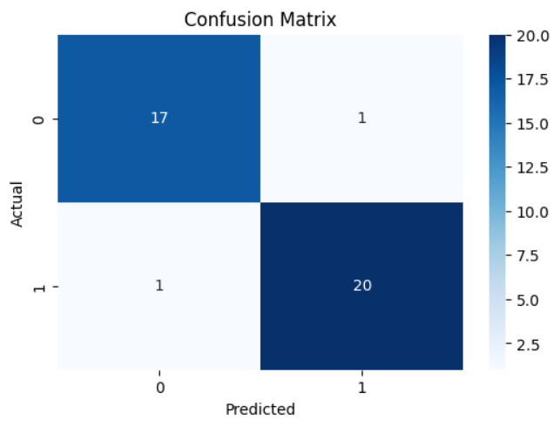
CONFUSION MATRIX
It compares actual values with predicted values to show how many predictions were correct or incorrect.
True Positive (TP= 20)
Model correctly predicted Disease
when the patient actually had disease.
True Negative (TN = 17)
Model correctly predicted No Disease.
False Positive (FP = 1)
Model predicted Disease, but the
patient was actually healthy.
False Negative (FN = 1)
Model predicted No Disease, but patient actually had disease

Slide 27
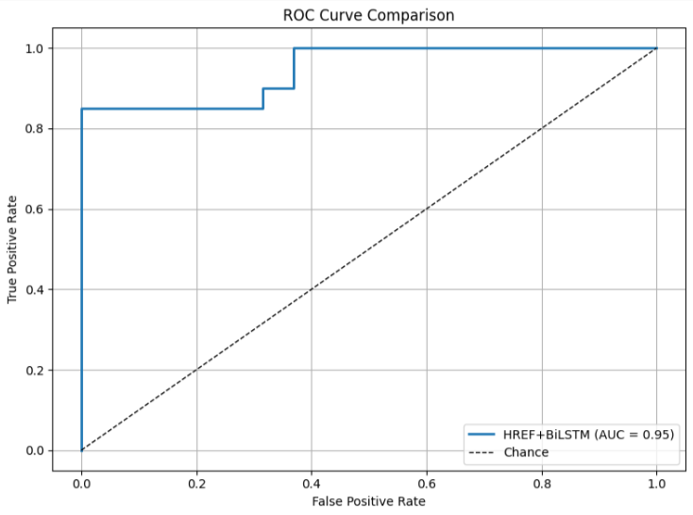
ROC-AUC
The model achieved a ROC-AUC score of 0.9474, indicating excellent class separation.
ROC curve is close to the top-left
corner, showing strong sensitivity and
Specificity.
High AUC means the model reliably
distinguishes between disease and no
disease cases.
Demonstrates strong overall
performance across different
classification thresholds

Slide 28
EVALUTION MATRIX
Accuracy
Measures how many predictions the model got correct.
Shows overall performance, but not enough when data is imbalanced.
Precision
Out of all predicted “Disease” cases, how many were actually correct?
Reduces unnecessary alarms for healthy patients.
Recall
Out of all actual “Disease” cases, how many did the model correctly identify?
Very important in medical diagnosis—missing a patient with disease (FN) can be dangerous.

Slide 29
4. F1-Score
Harmonic mean of Precision and Recall.
Ensures the model performs well on both classes, not biased toward any class.
Metric | Value
Accuracy | 94.7%
Precision(Class 0) | 0.94
Precision(Class 1 | 0.95
Recall (Class 0) | 0.94
Recall (Class 1) | 0.95
F1-Score (Class 0) | 0.94
F1-Score (Class 1) | 0.95

Slide 30
CONCLUSION & FUTURE SCOPE
Hybrid BiLSTM + HREF model delivers high accuracy and reliable performance.
Strong preprocessing (outlier removal, normalization, SMOTEENN) improves data quality.
Very low false positives and false negatives, making it suitable for medical diagnosis.
Future Scope:
Extend the model to larger, real-world clinical datasets for better generalization.
Implement advanced architectures like Transformers and Attention models.
Deploy the system as a web or mobile application for practical clinical use.

Slide 31
REFERENCES
N. S. Alghamdi, R. Alqahtani, M. Alhassan, and A. Alghamdi, “Predicting heart disease using a hybrid autoencoder-dense net model,” International Journal of Intelligent Engineering and Systems, vol. 17, no. 3, pp. 55–63, 2024.
J. J. Gabriel and L. J. Anbarasi, “Optimized feature selection and hyperparameter tuned lightgbm for cardiovascular disease detection,” Biomedical Signal Processing and Control, vol. 92, p. 105120, 2024.
S. Moturi, S. N. T. Rao, and S. Vemuru, “Optimized feature extraction and hybrid classification model for heart disease and breast cancer prediction,” International Journal of Recent Tech nology and Engineering, 2019.
K. V. N. Reddy, Y. Narendra, M. A. N. Reddy, A. Ramu, D. V. Reddy, and S. Moturi, “Automated traffic sign recognition via cnn deep learning,” in 2025 IEEE International Conference on Interdisciplinary Approaches in Technology and Management for Social Innovation (IATMSI). Gwalior, India: IEEE, 2025, pp. 1–6.
S. N. T. Rao et al., “Fake profile detection using machine learning,” in Proceedings of the 2025 IEEE International Conference on Interdisciplinary Approaches in Technology and Management for Social Innovation (IATMSI). Gwalior, India: IEEE, 2025, pp. 1–6.

Slide 32
THANK YOU

